Slide 1
Managing information to make life easier:
An introduction to records management

Slide 2
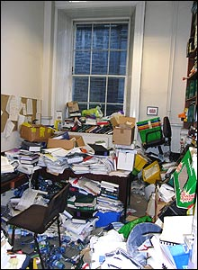
Why bother with records management?
Good records management:
Helps you to do your job better
Protects you and the University
Saves you time
Reduces costs
Gives you records you can rely on
“Information is a source of learning. But unless it is organized, processed, and available to the right people in a format for decision making, it is a burden, not a benefit.”
William Pollard (1828-1893)
Notes:
Records management: five key points
Good Records Management practice:
Helps you to do your job better: it supports ease and efficiency of working because you can find the information you need, when you need it. [E.g.] improved decision making because you have access to precedents – how did we handle this the last time it happened?
Protects you and the University: it provides evidence of people's rights and entitlements, and shows what the University did and why it did it. [E.g.] Helps to provide the records that auditors and regulators require and helps with internal procedures such as student complaint procedures and academic appeals.
Saves you time by ensuring you can find the information you need easily. There are a number of estimates for how much time you could save – some suggest half an hour a day, some less, but which of us couldn’t do with a bit more time?
Reduces costs, particularly space costs, by ensuring you don't keep any more records than you have to, and that you know when you can delete or destroy them. Does your unit have quantities of records? Perhaps hidden in rooms or basements? Your unit pays to use that space. If you don’t know what’s contained in those records or if you don’t know if you still need to keep them you are wasting resources and creating an FOI/DP risk because if a request is received and the information to answer it might be in those records, you need to search through them.
Gives you records you can rely on, both by helping you to find the appropriate version and, by giving records a high value as evidence if they are needed in a court of law. In an age of increasing litigation, proper, authentic records are increasingly important to ward off malicious litigation.
And since the implementation of FOI and DP, it is more important than ever that our records are accurate and that we manage them appropriately and effectively.

Slide 3
Records management is…
“A discipline which utilises an administrative system to direct and control the creation, version control, distribution, filing, retention, storage and disposal of records, in a way that is administratively and legally sound, whilst at the same time serving the operational needs of the University and preserving an adequate historical record”
(University Records Management Framework)
From the cradle to the grave
Creation, maintenance, use and disposal
Business activities & business need
Evidence
Systems
Research
Notes:
What does that mean?
Records management is interested in the whole lifecycle of the information we use – creation, maintenance, use and disposal.
It supports the University’s business activities and business needs.
It helps to ensure that records fulfil their evidential purpose.
Records management uses systems and procedures to help us manage our records
The University’s records management framework also explicitly refers to the need to keep an adequate historical record for future research.

Slide 4
What is a record?
“information
created, received, and maintained as evidence and information by an organisation or person, in pursuance of legal obligations or in the transaction of business”
University asset
Information
By-product of everyday business
Context
Evidence
Authentic
Any format
Notes:
Records management is concerned with records. In our context, a record is any recorded information held by the University, it is:
“information created, received, and maintained as evidence and information by an organisation or person, in pursuance of legal obligations or in the transaction of business”.
Records are University assets, they provide information and are a by-product of everyday business.

Slide 5
The University Secretary
Heads of units
All University staff
Records Management Section
Information practitioners
Aims of records management
The record is present
The record can be accessed
The record can be interpreted
The record can be trusted
The record can be maintained as long as necessary
Responsibility for records management
Notes:
Who is responsible for records management? The Records Management Policy Framework tells us that we all have records management responsibilities:
All University staff who create, receive and use records.
Heads of units have overall responsibility for ensuring that the records generated (created and received) by their unit’s activities are managed in accordance with the University’s policy.
Your local information practitioner has a co-ordinating role which includes taking the lead in implementing and maintaining local records management systems
The University Secretary has particular responsibility for ensuring that the University corporately meets its legal responsibilities, and internal and external governance and accountability requirements.
The Records Management Section has responsibility for advising on policy and best practice. The Centre for Research Collections is responsible for the University Archives which manages, preserves and makes available for study those University records which have long-term research value.

Slide 6
Freedom of Information (Scotland) Act
Anyone can request any recorded information held by the University
Implications:
Information is a corporate resource
Ensure information is accessible to relevant colleagues
Create clear and professional work documents
Keeping information we no longer need is a risk
Notes:
The Freedom of Information Act gives a general right of access to information held by the University, and all requests for information must be answered within 20 working days. On the basis that we cannot answer requests unless we know what we have and where to find it, the Freedom of Information (Scotland) Act includes a records management code of practice that we must comply with.
Implications
The legislation applies to information of any date, and means that almost all information created and received by the University may be open to scrutiny. The chances are that whatever you are working on somebody has a right to see it. So we should work on that assumption.
This means that we should think about our approach to document creation. Particularly when writing emails, check that you have communicated your message clearly and professionally. Re-read the message before sending, is that really what you meant to say?
We have only 20 working days to respond to freedom of information requests. As all requests for information count as freedom of information requests this means that virtually all correspondence must be answered within 20 working days. If you receive a request for information it is important to recognise it and either answer it or contact your local information practitioner for advice.
If you have inherited a cupboard of records you should examine what is there and determine whether or not it is necessary to keep it all. Keeping records that you do not need means that it is difficult to efficiently find the information you really need, especially given the 20 day response deadline.

Slide 7
Data protection legislation
Information about people:
Must be adequate, relevant and limited to what is necessary
Must be accurate and, where necessary, kept up to date
Must not be kept longer than is necessary
Must be kept in a way that ensures integrity and confidentiality
Implications:
Create accurate, ‘fit for purpose’ records
Create, maintain and use retention schedules
Appropriate version control and audit trails
Secure storage and disposal required
Notes:
Data protection legislation governs what we do with information about people, gives rights of access and requires us to keep information no longer than is necessary. The data protection principles set out what we can and cannot do with information about people; the ones with RM implications are detailed here. From 2018 whenever we collect information about people we will also need to tell them the retention period or retention criteria for the information we hold about them.
This means that:
When we create records about people we must ensure that they are accurate and contain sufficient detail for the purpose, but no more information than is required
We ensure records are stored, transported and used securely
We know how long we need to keep records because they are covered by an up to date retention schedule
At the end of the retention period records are securely destroyed.

Slide 8
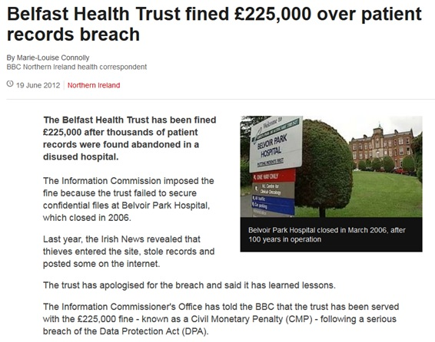
The importance of records management
What went wrong?
Failure to take responsibility for the records when staff moved
Retention policies had not been implemented
Inappropriate storage
Security systems were not properly maintained
Failure to take prompt action when the first indication of a problem arose
ICO Monetary Penalty Notice
Notes:
This is an example of how poor records management can contribute to a serious data protection breach.
Belfast Health Trust were fined £225K in 2012 following a serious data protection breach involving sensitive personal data of thousands of patients and staff, including medical records, X-rays, scans and lab results. In 2007 six local Trust merged into the BHSC Trust. The merger resulted in the Trust taking on the management of more than 50 largely disused sites. In March 2010 the Trust was informed that trespassers had gained access to one of the sites and taken photos of a number of patient records before posting them online. The Trust then carried out inspections of some of the site buildings and a large quantity of patient and staff records were discovered, some dating back to the 1950s. While the Trust took action to improve the security of the site, in 2011 it was still possible to access the site without authorisation. The Trust then increased the number of security guards and carried out a full inspection which revealed further records, many of which were retained in breach of the Trust’s retention schedule. The Trust failed to report the situation to the Information Commissioner. The ICO’s report noted:
“It was found that records on the site were stored either in boxes, in cabinets, on shelves or on the floor.”
“many of the records were damaged by damp and mould”
“an inspection of the whole site revealed the full scale of the problem and the discovery of further records many of which were being retained in breach of the data controller’s ‘Records Retention and Disposal’ policy.”
What can we learn from this?
Units are responsible for their records. If you move office location you can’t just leave your records behind
The extent and seriousness of data breaches can be reduced if we implement retention schedules
The importance of appropriate, secure storage for records that need to be kept
http://www.wired-gov.net/wg/wg-news-1.nsf/0/475C3608E00EE80F80257A2300444CA3?OpenDocument
http://www.bbc.co.uk/news/uk-northern-ireland-18497161

Slide 9
The Right to Know: An introduction to freedom of information
Answer any request for information within 20 working days
Avoid complications by following procedures and providing any easily releasable information that relates to your area of work
Contact your local information practitioner if you are unsure about any aspect of a request, it does not relate to your work or if you think there are grounds to refuse the request
Always take a clear and professional approach when creating documents. Remember all work documents, including emails, may need to be disclosed
Make your information accessible to other staff in your team so they can answer any requests for information in your absence
Find out more, Book your place via MyEd event booking; search for events provided by ‘Records Management’
Notes:
To find out more about freedom of information and data protection legislation, attend our lunchtime briefings. There’s one focused on freedom of information and responding to requests for information, and one on data protection legislation

Slide 10
Data protection law
When collecting personal data, provide a privacy notice detailing how data are used, with whom they are shared, and the retention period
If someone asks to see information the University holds about them or queries our use of information about them, contact your local Information Practitioner ASAP
Keep personal data securely, e.g. use strong passwords, encrypt data not held on University networks, and ensure you send emails to the correct recipient
Always do a privacy impact assessment when you plan a new project or review an existing process so privacy requirements can be met by design
Do not keep personal data longer than necessary; refer to the relevant retention schedule
Find out more, complete the mandatory data protection training for staff
Notes:
We’ve also touched on occasions where freedom of information and data protection legislation meet. Data protection governs what we can and cannot do with information about people. It protects the rights of individuals and places responsibilities on all staff. Data protection legislation helps us to balance individual privacy and legitimate uses of personal information. The law has recently changed, new data protection training is available through LEARN.

Slide 11
Relevant legislation and regulations
Includes…
Research Council funding requirements, e.g.
  Reporting requirements
  Concerning the management of research data
Financial legislation and regulations, e.g.
  Taxes Management Act 1970
Employment legislation and regulations, e.g.
  Sex Discrimination Act 1975
  Disability Discrimination Act 1995
Health and safety legislation and regulations, e.g.
  Health and Safety at Work Act 1974
Notes:
[Quickly]
Other relevant legislation and regulations are listed on this slide.
If you work with financial records you’ll be aware of the need to keep most golden copy financial records for the current year plus 6 years.
If you hold health and safety records, e.g. records documenting pre-employment health screening of an employee exposed to hazardous substances, you’ll be aware that there are some records you need to keep for 40 years after termination of employment.
If you’re involved in research administration, you’ll understand the importance of fulfilling the relevant Research Council funding requirements. In 2012/13 the EPSRC clawed back £291,132 from UoE for failing to submit adequate financial reports.
https://www.timeshighereducation.com/news/research-councils-claw-back-millions-for-late-reporting/2007024.article

Slide 12
Records management good practice for all
Notes:
OK, so hopefully we now understand why RM is important…. Now for some practical guidance….

Slide 13

Creating records
Consider the purpose of the record
  Ensure that the record fulfils its purpose
  Do not create records unnecessarily
Document the University’s activities
  Be sure of the facts
  Provide evidence
Is it about an identifiable, living individual?
  Ensure that the information is relevant, accurate and not excessive
Image: ©iStock.com/skynesher
Notes:
Some practical guidance concerning things you should consider when creating records
Before creating a record, consider its purpose. Ensure that you include all the information necessary to achieve that purpose, but do not include extraneous information. Avoid creating records unnecessarily, because we must then put time and effort into managing them.
Create records to document the University’s activities and to provide evidence of business activities and to ensure that the historical record is complete.
If the record is about an identifiable, living individual remember that the Data Protection Act applies so you should ensure that the information recorded about the individual is relevant, accurate but not excessive. In particular remember:
Do not express opinions that you are not prepared to defend or which you cannot substantiate
Do not express opinions in areas where you are not qualified
Do not write in anger or in haste
Always be respectful, even when expressing negative information
Further guidance on the issues to consider when creating records is available on the Records Management Section website. This guidance goes into detail about the particular issues to be aware of when writing about individuals, when providing references, when writing emails and when preparing committee papers and minutes.
IF WE LIKE THE IMAGE: http://www.istockphoto.com/gb/photo/above-view-of-woman-s-hand-writing-gm468566430-61845944?st=_p_Writing

Slide 14

Organising records
Create files
  Containing information on the same issues/ responsibility/ transaction
  Designate a single, lead file or ‘golden’ copy
Storage of records
  Accessible to all relevant staff
Format – paper, electronic, microfilm, etc.
  Irrespective of the format, use the same records management principles
Image: ©iStock.com/hh5800
Notes:
How should we organise our records?
Organise your records into files of information relating to the same issue, responsibility or transaction. For most topics there should be a single lead file. This will be the file of the person or unit who has the lead on the topic concerned, for example, a committee secretary’s set of minutes and papers. Other members of staff may also have a file on the same subject that they keep only for so long as is needed for their personal reference, but you should ensure that the lead file gives the complete story of our handling of the issue.
If the content of a record is important, it should be added to the file on the subject and stored so that it will always be accessible to all relevant members of staff. Only when there are confidentiality issues involved would it be appropriate to keep a record in a personal drive or a personal e-mail box.
Records may be kept as paper files, or electronically in shared drives, databases, or document management systems.
Irrespective of the method chosen to keep the records, a standard set of records management principles and tools can be used to manage them. The more important of these are filing schemes and retention schedules. I’ll say more about these towards the end.
IF WE LIKE THE IMAGE: http://www.istockphoto.com/gb/photo/folders-and-files-gm171298935-20724106

Slide 15
What to file
The general rule:
If a record relates to the thing that you are primarily responsible for, it is a function of the University and needed by you or others for more than six months then the record should be filed so that it is accessible
You should normally file records that:
Show the reasons why something has been accepted or rejected or why something has been done or not done
Show who was involved in decision-making
Contain financial papers or statistics relating to your role’s activities
Relate to the success or failure of any work relating to your role’s activities

Slide 16
When to keep a draft
Working drafts: For the eyes of the creator only
Can usually be overwritten, deleted or destroyed as soon as they are superseded
Approval or consultation drafts: Shared with others for comment
It is usually only necessary to keep them when it is a major document and there have been major policy changes
Final versions: Versions that are sent/shared with intended recipients
These should be captured into your formal record keeping system
Notes:
Examples of items that should not be included in the formal record keeping systems and can be destroyed on a regular basis are:
Duplicate documents such as ‘CC’ and ‘FYI’ copies, and unaltered drafts
Announcements and notices of meetings and other events, and notifications of acceptance or apologies
Requests for stock information such as maps, travel directions etc.
Requests for, and confirmations of, reservations for internal services (e.g. meeting rooms) where no internal charges are made
Transmission documents (e.g. letters, FAX cover sheets, email messages, routing slips, compliments slips etc) which accompany documents but do not add any value to them.
Message slips
Superseded address lists, distribution lists etc.
Copies of personal expense claims
Personal diaries, address books etc.
Copies of minutes and papers sent for information only.
Notes taken at meetings. The committee secretary will keep the approved version of the minutes; all other notes should be destroyed once the minutes have been approved.
Working papers, where the results have been written into an official document and which are not required to support it.
Published or reference materials received from other parts of the institution or from vendors or other external organisations which require no action and are not needed for ‘record’ purposes.

Slide 17
How long should we keep records?
Ask your local Information Practitioner about your unit’s local retention schedule
  Ensure the schedule is updated to include the information you create and use
If it is personal data, refer to the relevant privacy notice
For other types of information refer to the University-wide retention guidance for:
  Committee information - Financial records - Health and safety records
  Planning records - Student records - Web content
  Creating and reviewing retention schedules
Notes:
As already explained, it is important that we do not keep information longer than we need it. Ask your local practitioner for a copy of your unit’s retention schedule which will tell you how long to keep your records. Your local retention schedule should be based on the University-wide retention schedules on our website which give the minimum length of time we must keep records. If you need to keep information for longer than the minimum period, record this, and the reason for it on your local retention schedule.
Our website contains links to retention advice for:
Committee information
Financial records
Health and safety records
HR records
Planning records
Student records
School records
Web content
Once information is no longer needed it should either be destroyed or transferred to the University Archive depending what the retention schedule says. If it is to be destroyed follow the procedures for disposing of records and use the most appropriate method for the information concerned. For example, sensitive papers such as job applications should be shredded or put in confidential waste sacks. Electronic records should be deleted and the recycle bin emptied. CDs and USB sticks that have contained sensitive information should be physically destroyed. PCs should be disposed of following the University’s procedures.

Slide 18
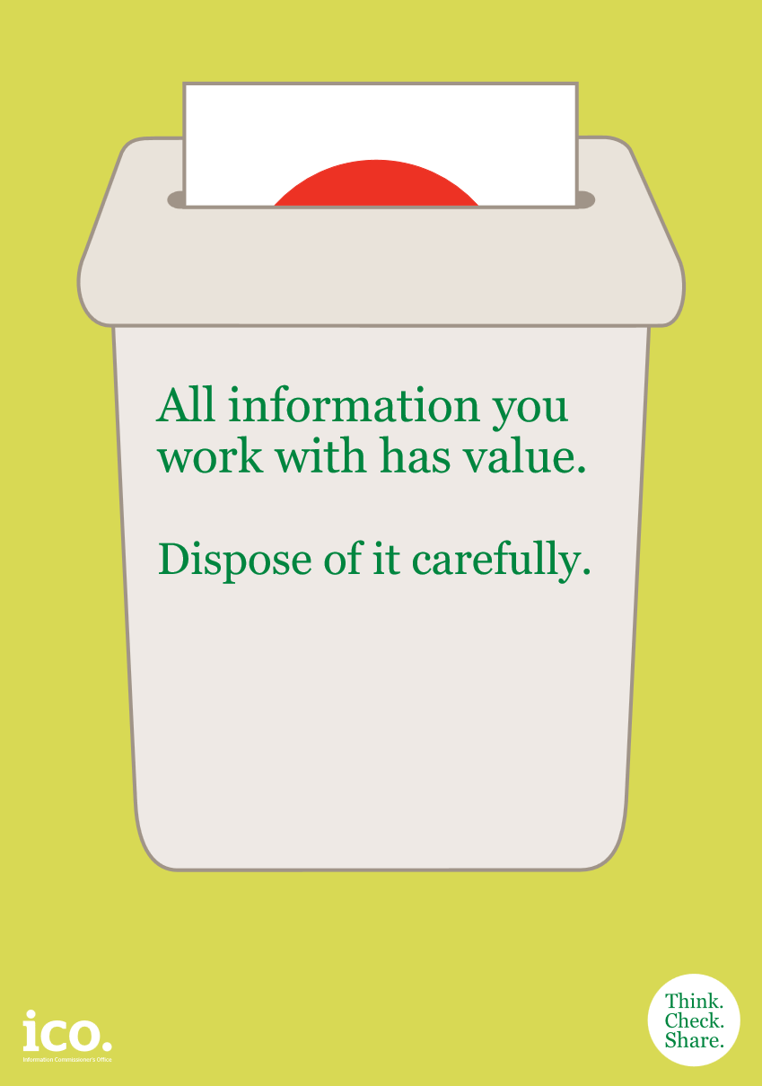
Dispose of records carefully
Transfer to University Archive
  Records meeting the archival selection criteria
University waste disposal and recycling services for all other records/equipment
  Paper recycling, for papers containing published information
  Confidential waste, for everything else
  Do not give/sell equipment to third parties
  Equipment used for high risk info, must be destroyed and not passed within the University
Notes:
As already explained, it is important that we do not keep information longer than we need it. Ask your local practitioner for a copy of your unit’s retention schedule which will tell you how long to keep your records. Your local retention schedule should be based on the University-wide retention schedules on our website which give the minimum length of time we must keep records. If you need to keep information for longer than the minimum period, record this, and the reason for it on your local retention schedule.
Our website contains links to retention advice for:
Committee information
Financial records
Health and safety records
HR records
Planning records
Student records
School records
Web content
Once information is no longer needed it should either be destroyed or transferred to the University Archive depending what the retention schedule says. If it is to be destroyed follow the procedures for disposing of records and use the most appropriate method for the information concerned. For example, sensitive papers such as job applications should be shredded or put in confidential waste sacks. Electronic records should be deleted and the recycle bin emptied. CDs and USB sticks that have contained sensitive information should be physically destroyed. PCs should be disposed of following the University’s procedures.

Slide 19

Managing email
Issues to consider:
  Work emails are University documents
  Work emails may be open to scrutiny
  Email is not secure
Recommended management techniques:
  File important emails so that they are accessible to others
  Delete unwanted emails
  When replying, keep the original text as part of your response
  Set up a separate folder for personal emails
Image: ©iStock.com/Chunumunu
Notes:
Some practical guidance for managing your email:
Remember that your work emails are University documents and FOI and DP apply to them.
When using email remember that it is not a secure form of communication, in many respects sending an email is like sending a postcard. So don’t use email to send sensitive information unless it is encrypted.
When managing your emails it is particularly important to file important emails so that they are accessible to your colleagues. For example, you could save them to the shared drive with the other information on that topic, or you might print them off and put them on the appropriate file.
Remember to delete unwanted emails on a regular basis, including your sent items. If you have been filing your important emails as you work, you can easily delete the items in your account at regular intervals.
When replying to an email keep the original text as part of your response so that the record shows what you were responding to. For example an email just saying ‘yes’ is not helpful without the context of the question it is answering.
We recommend that if you use your email for personal use, that you set up a separate folder for personal emails and clearly label it so that if it is necessary to search your email folders for information in response to a request, it will be possible to avoid looking at your personal emails.
There is further detailed guidance on managing your emails on the Records Management Section website.
IF WE LIKE THE IMAGE IT IS FROM: http://www.istockphoto.com/gb/photo/picking-the-right-mail-gm466344946-59706228?st=_p_email

Slide 20

Managing electronic records
Issues to consider:
  Legal admissibility
  Preservation
Recommended management techniques:
  If possible use a (R)DMS, if not use shared drives
  Keep the directory structure intelligible
  Keep file titles brief and meaningful
  Version control
  File naming conventions
Notes:
As said previously, records can come in different formats including electronic and email formats. The format does not make any difference to the record keeping principles, but some formats present special challenges.
When managing electronic records it is particularly important to consider the legal admissibility and preservation requirements of the records. Electronic records and emails are increasingly being relied on as evidence in court so it is important that if necessary the University’s records are legally admissible. The legal admissibility of electronic records is a complex subject but if you think legal admissibility may be an issue for your records you should consult the guidance on the Records Management Section website.
Electronic records are fragile and, unlike paper, are unlikely to be around in a few years unless we take action to ensure their preservation at the start of their life span. If you have electronic records that need to be accessible for 10 or more years you need to put in place a preservation strategy. Further advice and guidance is available from the Records Management Section and the Centre for Research Collections.
When managing your electronic records we recommend that rather than saving University records to personal drives, that you save records to shared drives so that your colleagues also have access to your information.
It is recommended that you keep the directory structure easily intelligible, avoid naming folders after yourself or giving them a name that is not easily recognisable to colleagues. Where you have a filing scheme we suggest that you use the filing scheme as your directory structure.
When saving electronic documents try to keep file titles brief and meaningful.
So that it is clear which version of a document is being referred to ensure that you give each new version of a document a new number and use the ‘save as’ option to avoid overwriting the original version.

Slide 21
Records Management Best Practice
Do:
Organise your records into files
Store records in such a way that any other user can readily find relevant information
Ensure that work done at home is added into your unit’s records systems
Mark personal material clearly as such
Remember every email is a University record
Store important email information with the relevant file(s)

Slide 22
Records Management Best Practice
Don’t:
Keep records for any longer than they are needed
Keep files that duplicate information held elsewhere in your unit (except to meet short-term operational requirements)
Keep University records on personal drives, unless it is highly confidential
Keep sensitive University information on your home computer
Store information on your c: drive
Name folders on shared drives after yourself

Slide 23
Route map for information practitioners
Notes:
I’m now going to introduce an outline route map for Information Practitioners or those with responsibility for co-ordinating records management for their units. This is the more technical bit and relevant if you’ve been tasked with developing systems and procedures for your unit.

Slide 24
Records management tools
Notes:
How do we put in place good RM systems?
The RM route map shows the questions that RM asks (down the left side), and the tools that we use to answer them (in the boxes to the right). Implementing these tools is how we implement good records management.
If you are a practitioner or have an RM co-ordinating role in your unit…. Follow the technical guidance on our website to develop and implement these tools. The most important ones are a filing scheme and retention schedule.

Slide 25
Creating a filing scheme
Hierarchy with max. 4 levels:
Level 1: broad categories / ‘functions’
Levels 2-3: more refined categories / ‘activities’
Level 4: folders to file your records
Only file records at bottom level
Tip: Use the skeleton scheme as your starting point
Notes:
Filing schemes look like this…
You might only need a 3 level hierarchy, depending on the size and complexity of your unit.

Slide 26
Extract from schools’ outline filing scheme
A. Teaching
A.1. Taught Course Delivery
A.1.1. Class lists
A.1.2. Course handouts
A.2. Taught Course Assessment
A.2.1. Exam marks
Level 2
Level 3
A.1.3. Coursework submissions
A.2.2. Board of Examiners
A.2.3. Exam timetables
Level 1
Notes:
There is an outline filing scheme for schools on the Records Management Section website, this is an extract from it. It shows a three level hierarchy:
Level 1 – Function
Level 2 – Activity
Level 3 – More detailed activities

Slide 27
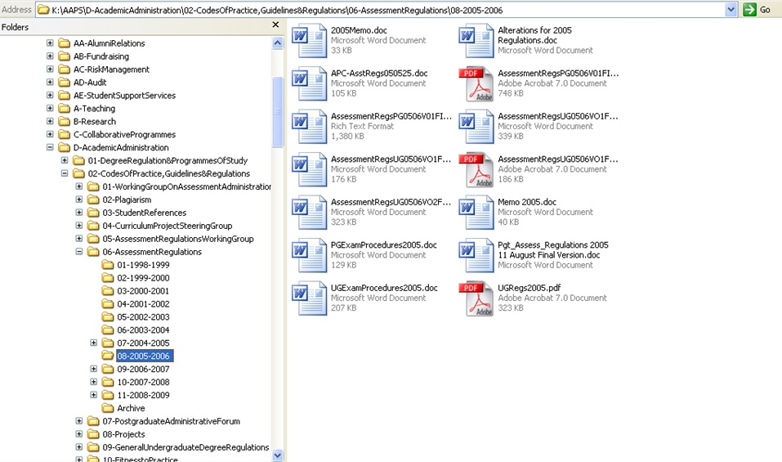
An example of an electronic filing scheme
Notes:
This is a screen shot from the implementation of a filing scheme using a shared drive. You can see the 4 levels and the documents being filed at level 4.

Slide 28
Creating a retention schedule
Duplicate records vs. ‘golden’ copies
Legal or regulatory requirements?
Current business processes
Document business processes/ decisions taken/ actions carried out for future reference
Accountability purposes?
Long-term research value?
Your retention schedule should be:
    Approved by your head of unit
    Published on your website
    The link sent to recordsmanagement@ed.ac.uk
Tip: Use the existing University-wide retention schedules as your starting point
Notes:
If your records are not yet covered by a retention schedule, you can work out a retention period for your records by considering these factors –
Designate ‘golden’ copies of records so that others with duplicate copies know that they can dispose of their set as soon as they no longer need to refer to them. E.g. committee secretaries are responsible for committee minutes, papers etc. If you are a meeting attendee you should dispose of your copies of the documents as soon as the meeting is over, and you can dispose of your meeting notes as soon as you have completed your action points and the minutes of the meeting have been agreed.
Are there any legal or regulatory requirements which affect how long you need to keep your records? If so take these into account when you decide how long you need to keep the records.
How long will there be a continuing need for the records for current business processes?
How long are the records needed after their immediate business need has lapsed, e.g. are they needed to provide evidence of decisions made or needed to show how a process was managed last year for next year’s reference?
Are the records needed for accountability purposes? If so, for how long are they needed?
Do the records have long-term research value? Advice and guidance on this are available on the University Archives website and from the University Archivist.
Further guidance on these sorts of issues can be found in the guidance on creating a retention schedule on the Records Management Section website.

Slide 29
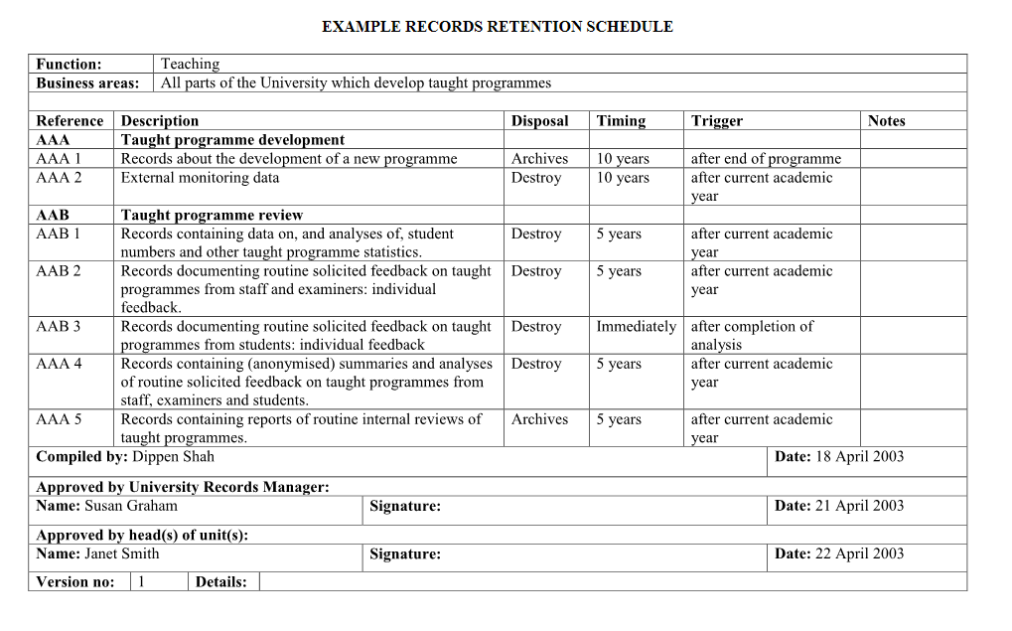
Notes:
Retention schedules come in various formats, this is an example of one way to present your retention schedule.
The key items you need are:
1. A description of the records to which you are referring so that there is no confusion. You can do this by giving the folder reference number and title.
2. What needs to happen to the records at the end of the retention period? Should they be destroyed or transferred to the University Archive?
3. How long do you need to keep the records? May be expressed in years or months.
4. The point at which the retention period starts ticking down is the ‘trigger’. This needs to be something that can be implemented, e.g. ‘end of academic year’. ‘When decision about X is made’ is unlikely to be readily implementable as it will probably not be readily apparent when that happens.

Slide 30
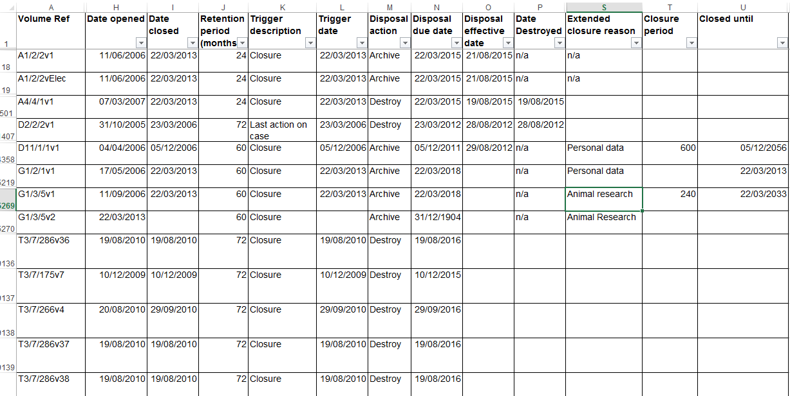
Example retention & disposal spreadsheet
Notes:
This is an example of a spreadsheet used to record and implement retention periods.

Slide 31
Filing systems: What to think about
Procedures:
  Users
  System management staff
Scope of system:
  Central or devolved
  Electronic and paper?
  Services provided / self-service?
  Who is responsible for ensuring information is appropriately filed?
Infrastructure
  (R)DMS?
  Physical storage: cabinets; off-site?
Folder management
  Opening folders
  Audit controls?
  Tracking physical folders?
  Closing folders: When? Who?
  Destruction procedures
Notes:
Your filing system will need two sets of procedures: one for the system users, and one for the staff maintaining the system.
You’ll need to make decisions about the physical infrastructure you use. What type of folder covers will you use? You’ll want to avoid plastic which tends not to last well. Will you use on-site filing cabinets and if so which type – with drawers or doors? Or will you use off-site storage and boxes?
Will your system be centralised where only designated staff create and maintain the folders, or will it be devolved to make users responsible? Will the system be paper or electronic only, or will it allow both? Will stall provide hands-on filing services or will it be user self-service? Whatever the scope, you need to ensure responsibilities are clearly defined and communicated.

Slide 32
Implementation step 1: Assess and prioritise
Self-assessment checklist
  Identify existing good practice
  Identify gaps or areas of weakness
Model action plan
  Scale to your unit; you won’t need to do everything
  Prioritise
  The self-assessment checklist and model action plan are currently being revised, please contact recordsmanagement@ed.ac.uk if you need a copy now.
Notes:
First start off by using the records management self assessment checklist. Try to answer the questions for your whole unit, if you can’t, ask others in your unit to help you with it. The checklist will help you to identify areas where your unit already has good records management practice and will help to identify gaps or areas of weakness. This can then be used as the basis for planning your records management programme in conjunction with the records management model action plan.
The records management model action plan lists the types of activities that units need to do to implement good records management. Not all units will need to do all activities, make sure that you read the “Unnecessary if…” column! If your unit is small your records management solutions are also likely to be small, if you don’t need an all singing all dancing centralised system, don’t try to implement one.
(I suggest you ignore the dates given in the action plan as these were designed to get everyone ready for Freedom of information.)

Slide 33
Implementation step 2: Plan
Develop your own action plan based on your assessment and priorities
  Use the technical guidance, tools and examples
  Identify collaborators to work with
  Identify stakeholders you need to consult
  Create a project plan which breaks the work into manageable chunks
Meet with the Records Management Section to discuss your plans
Notes:
Your next step is to develop your own records management action plan based on your checklist responses and knowledge of the priority issues for your area. But normally it is best to start with your filing scheme, then your retention schedule and move on from there.
Refer to the technical guidance available on the RMS website
Think about what pre-existing materials you might want to use – has another school or unit done something similar? E.g. the school filing scheme developed by CHSS
Is there anyone you can work with? Perhaps Information Practitioners in similar areas?
Before you get too far along the road to implementation identify who you need to consult – a management committee, the users of the new system?
When are you going to start work, what do you aim to have completed by when? Who will help you?
Plan what you are going to tackle first, what you need to do to achieve it and think about when you want to have it done by. Do that for each element of your programme, until you have your full plan.
When you’re ready, get in touch and arrange a meeting with me (or one of my colleagues); we’d be happy to talk about your plans and pass on any tips we can.

Slide 34
Advice and assistance
Your local Information Practitioner
  www.ed.ac.uk/records-management/foi-practitioners
The Records Management Section
  www.ed.ac.uk/records-management
  recordsmanagement@ed.ac.uk
  0131 651 4099
Notes:
If you’re not sure who is your local Information Practitioner, you can look them up on the Records Management Section website, where you will also find lots more information and guidance.
If you have a query that isn’t answered on the website, please send us an email.

Slide 35
Thank you! comments? questions?
Notes:
Does anyone have any further questions or comments?
Thank you all for your attention. We’ll send you a link to the slides and a feedback form, and I’d be grateful if you could take a couple of minutes to complete it.

